Slide 1

Market EnTry
SVA Qualification

Slide 2
Slide 2: SVA Qualification overview
Performance Assurance Framework
Qualification
QSP/Elexon
Planning Meeting
Self Assessment Document
Witness Testing
PAB Approval
Notes:
Performance Assurance Framework – SVA Qualification is part of the PAF which is made up of the techniques used by the Performance Assurance Board (PAB) to manage risks to Settlement.
Qualification – is a preventive technique and it allows us to test that your systems and processes are sufficient to commence live operations.
The Qualification Service Provider (QSP) provides technical expertise, reviews your application and conducts witness testing at your offices. You will be introduced during the planning meeting).
Self-Assessment Document (SAD) - this is the main focus of the Qualification process, populating the SAD is also the most time consuming process within the Qualification process.
Witness Testing- The QSP will conduct site visit to test that the correct approach has been followed by the applicant.
PAB approval - The final stage of SVA Qualification will be to gain approval from the Performance Assurance Board

Slide 3

Slide 3: Self Assessment Document
The SAD is split into 20 sections
Generic Sections
1. Introduction
2. Project Management
3. Testing
4. Operational Security and Controls
5. Chance Management and Risk Assessment Process
6. Management, Resource Planning and Local Working Procedures
7. Initial Data Population and/or Data Migration
Specific Sections
8. NHH DC
9. HHDC
10. NHHDA
11. HHDA
12. SMRA
13. SVA HHMOA
14. SVA NHHMOA
15. CVA MOA
16. Meter Administrator
17. UMSO
18. Supplier
19. Virtual Lead Party
20. LDSO
Iterative Process
Notes:
Once you’re ready to start SVA Qualification, please submit your project plan and let us know your availability in the coming weeks. We will then have a planning meeting with our QSP and we’ll use your project plan to determine a suitable timeline.
The SAD is the key focus for Qualification Applications. It’s the most time consuming process because the applicants are required to have developed and tested their systems before SAD population and the business process would be required to have been decided before SAD completion.
SAD declarations demonstrate how new entrants’ systems and processes meet requirements of the Code and CSDs, and how existing participants’ systems and processes continue to meet those requirements.
The SAD can be completed in sections, so you can send those sections through to KPMG for review to get some feedback along the way and it’s an iterative process until the SAD is finalized. Please make sure you submit each section in full if you were to submit the SAD by section.
Once the applicant is ready to submit the SAD, KPMG will provide a secure transfer network, which is password protected to the applicant for SAD submission.
The SAD is split into two sections:
Generic sections – All applicants are required to respond to all the questions in the generic section of the SAD except for VLPs who are only required to complete 1-6. Applicants are advised to focus on section 3 – Testing. This is where applicants carry out internal testing of their proposed systems using the testing guidance lines in appendix 1 of the SAD and the joint story boards to ensure systems can send and accept all relevant flows for the role they wish to qualify for.
Then there’s the Roles specific sections – Applicants are required to provide responses for the role or roles they wish to Qualify, for example a VLP would only need to respond to section 19.

Slide 4
Slide 4: SAD Section Cover Page
Objective Statement
Objectives of this section
To ensure that the testing carried out by the Applicant can be relied upon to check that additional risk does not enter Settlement and that current and future Market Participants are not adversely impacted.
To provide assurance that the testing plans and procedures followed (in respect of IT and/or manual processes) are of sufficient rigour to ensure that these risks are adequately addressed.
Guidance for completing this section
The Applicant should be able to demonstrate that they have a comprehensive, documented approach to testing of the systems being developed that is appropriate for the relative complexity of the system.
Where an Applicant has indicated that the evidence to support a response is the testing conducted, as part of Entry Processes then this evidence will not be reviewed as part of the process. The QSP will review the response only. In completing the response the Applicant will need to demonstrate that they have satisfied themselves that the BSC requirements have been met and that the test evidence is appropriate for the specific response made.
Applicants that have relied on a third party supplier for the development of their systems should respond to subsections 3.1 and 3.4 in addition to either 3.2 or 3.3. The questions in subsections 3.2 or 3.3 may require the Applicant to seek assistance from the third party in order to provide a response, however in all cases the responses are the responsibility of the Applicant. There may be an overlap in responses given and the Applicant should consider the most appropriate way to co-ordinate their own responses and those of the third party provider.
Section Guidance
Notes:
Each section of the SAD has a cover page which provides an objective statement for that section as well as some detailed guidance for answering the questions within that section.

Slide 5
Slide 5: SAD Sample Question Format
Question
Response
3.2.5 How are you able to demonstrate that all planned testing has been completed?
Evidence of completion is expected to
include a test completion report. Where planned testing has not been completed an explanation as to why this has been the case should be provided within the supporting evidence.
It is anticipated that all high severity faults will have been cleared and this should be confirmed within any test completion report provided.
Guidance & Requirements
Evidence
Notes:
Each question on the SAD has further guidance on the requirements and how to answer that question, then 2 blank spaces. The first blank space it to answer the question and the second is to provide supporting evidence.
For example if the applicants is answering a question on security policies, the first blank space would be to answer the question by providing information about their security policies and the second blank space would be to attach a copy of their security policy.
The level of supporting evidence and witness testing required will vary per applicant depending on the risk assigned to their application.

Slide 6
Slide 6: Witness Testing
Following review of the SAD the QSP provides an outline (scope) of the tests to be witnessed in advance.
The aim of witness testing is to test that the approach has been followed and tests have been fully completed and exceptions resolved
Sample basis
This involves the QSP team sitting alongside an Applicant's tester/user and watching them execute a sample of tests in real-time
Duration varies dependent on risk. Generally lasts between 1-2 days to 2 weeks.
Additional guidance notes available on key areas of the Qualification Process
  Testing Storyboards
  Approach to Witness Testing
Notes:
Following review of the SAD the QSP will provide the scope of the tests to be witnessed in advance.
The aim of witness testing is to test that the approach has been followed and tests have been fully completed and exceptions resolved.
The testing will be on a sample basis however we recommend testing all scenarios as part of your own internal testing.
The extent of Witness Testing will be dependent on a number of factors:
the level of controls both documented and evidenced by the Applicant on the SAD;
the risk of the proposed system to be used in provision of the Qualified service;
the prior experience of the Applicant;
the complexity of the proposed systems and service; and
The number of issues identified during an applicant’s own testing
The QSP is able to carry out Witness Testing with applicants remotely. The QSP would look to accommodate your preferred method for Witness Testing, whether virtually or in person, depending on the risk of the application and government restrictions at that time.
After the witness testing, KPMG will produce an outcome report. VLPs do not undertake Witness Testing and their outcome report will be produced based on their SAD responses.

Slide 7
Slide 7: PAB approval and timelines
PAB Dates | Meeting Number
28/01/2021 | 240
25/02/2021 | 241
25/03/2021 | 242
29/04/2021 | 243
27/05/2021 | 244
24/06/2021 | 245
29/07/2021 | 246
26/08/2021 | 247
30/09/2021 | 248
28/10/2021 | 249
25/11/2021 | 250
16/12/2021 | 251
PAB Date
25 November 2021
External paper day
(Final reports sent to PAB members)
18 November 2021
QSP findings report sent to ELEXON
4 November 2021
Notes:
ELEXON will use this outcome report to write a paper with a recommendation to the Performance Assurance Board (PAB)
The Qualification process for a VLP is expected to take up to 4 months for applicants, but for other roles, it can take between 6-9months.
We normally ask applicants to allow for approximately 6 weeks at the end of the timeline of the Qualification process to allow ELEXON and KPMG to complete their internal processes. Let’s work backwards from the PAB date. If an applicant is aiming for a November PAB, ELEXON is expected to send the PAB paper out to PAB members 1 week before the PAB meeting. KPMG is expected to send the outcome report to ELEXON 2 weeks before the papers are sent to PAB members.
The table on the right shows the PAB meeting dates for 2021. They are held on the last Thursday of every month except December which is brought forward due to the Christmas period.
It is then ultimately the PABs decision to approve the applicant’s application to enter the market at its meeting.

Slide 8
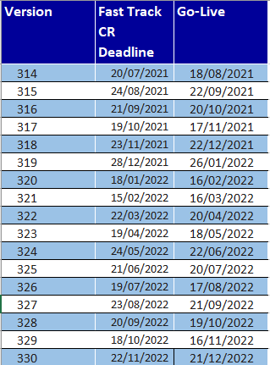
Market Domain Data Registration
All Party Agents will need to register in MDD and BSCP509, and Entity Forms 1 and 45
The following data items are required to be set up in MDD
Market Participant Id
Market Participant Role Code

Slide 9
Slide 8: MRASCo Entry Processes
The Master Registration Agreement (MRA) is the multi-party agreement between all licensed electricity Distribution Businesses and Suppliers
It is mandatory for Suppliers and Distribution Businesses within the Electricity Industry to accede to the MRA in order to fulfil their licence obligations
It sets out terms for the provision of Metering Point Administration Services (MPAS Registrations), and procedures in relation to the Change of Supplier to any premise/metering point
Notes:
The Master Registration Agreement (MRA) is the multi-party agreement between all licensed electricity Distribution Businesses and Suppliers.
It is mandatory for Suppliers and Distribution Businesses within the Electricity Industry to accede to the MRA in order to fulfil their licence obligations
It sets out terms for the provision of Metering Point Administration Services (MPAS Registrations), and procedures in relation to the Change of Supplier to any premise/metering point

Slide 10
Slide 9: MRASCo and Elexon Qualification interaction
MRA
BSC
Initial Briefings
Initial Briefings
Risk Assessment
Indicates a synergy, where ELEXON & MRASCo can co-ordinate to save overhead for the Applicant.
Reporting & Approval
-
MEC
High Level Planning
High Level Planning
Business Solution Assessment
Evaluation of
Integration Test Assessment
Self Assessment
T
Document and
Indicates a synergy where the same information used may also be used by the process at the arrowhead.
The red dividing line signifies governance. The blue dividing lines signify stages of the process. Stages are sequential, commencing at the top of the diagram, with stages that may be undertaken in parallel indicated.
i
Risk Assessment
Supporting Evidence
m
Reporting & Approval
-
MEC
e
l
i
n
Data Transfer
Market Scenarios
Witnessed Testing
e
Testing
Assessment
( if/as required)
Reporting & Approval
-
MEC
Reporting & Approval
-
PAB
Controlled Market Entry
Reporting
-
MEC
Notes:
We work in conjunction with MRA for Supplier and DNO (SMRA, UMSO, LDSO) Qualification applications. The aim is to reduce overhead for the applicant and reduce the amount of tests the applicant would be required to complete.
Some of our interactions are outlined on this slide.
The initial briefing or planning meeting is conducted jointly.
The applicant completes questions for both codes, BSA for MRA and SAD for BSC.
Some of the evidence from the Market scenario testing would need to be used as supporting evidence for the SAD.
Finally, the MEC approves the MRA market entry assessment and the PAB approves the BSC Qualification application.
MEC is held on the last Tuesdays of every month and PAB is on the last Thursdays. If there are delays on the MRA side and we complete all relevant BSC testing, we would still take the BSC Qualification to the PAB.
As of September 2021 the MRA will crease to exist and the Retail Energy Code will take on the applications for Suppliers, LDSOs and Meter Operators. We will continue to work with the REC in a similar way to the MRA, however we suggest that you contact the REC separately to discuss your application.

Slide 11
Slide 10: Extra Considerations
DCUSA – Distribution Connection & Use of Systems Agreement (ElectraLink)
CUSC – Connection and Use of System Code (National Grid)
BSC (ELEXON) and Electricity Market Reform (EMR)
MRA – Master Registration Agreement (As of 01/09/2021 Retail Energy Code (REC))
Notes:
EMR – carry out the settlement of Contract for Difference (CFD) and Capacity Market (CM) agreements.
ElectraLink’s Data Transfer Network (DTN) - supports data transmission across the electricity industry.
CUSC - the contractual framework for connection to, and use of, National Grid’s high voltage transmission system.
We will also send you some further information on Industry codes after this meeting.

Slide 12
Slide 11: Additional Information
- Annual BSC Audit
- Technical Assurance Check
Performance Assurance Techniques
(Post Qualification)
BSC Portal
- Provides operational BSC data
- Public as well as party-specific data
Introducing Elexon Seminar
- Overview of the balancing mechanism and imbalance settlement processes (Dates TBC)
Communications
- Mailbox for Industry News
- News Casts and Circulars
Notes:
Qualified Persons are required to register their details in Market Domain Data (MDD) by completing the BSCP509 and relevant entity forms and the registration is made using a Market Participant Identifier (MPID). If you have an MPID in mind at the planning meeting stage, then you can email us to reserve the MPID.
The registration date will need to align with the MDD Release Schedule which you can find on our website. Suppliers and LDSOs can register in MDD before PAB approval.
Some post Qualification techniques which can be applied once you become operational are:
Annual BSC Audit – this is conducted annually by the BSC Auditor, normally for Qualified Persons who have at least 50,000 metering point for NHH and/or 500 for HH.
Technical Assurance Check - This is where ELEXON identifies a market wide issue and perform a sample base audit to understand if that issue is a potential risk to settlement.
BSC Portal - this provides market wide data and party specific data – sign up to the portal to gain access to data.
Introducing ELEXON seminar - encourage Parties especially Suppliers and LSDO’s to attend. This is usually held 5 times a year in our offices. However, due to restricted office use under the Covid climate, the next seminar dates are yet to be confirmed. In the meantime, we have published a free online version of the seminar. You can find the video course on our website.
Communication: sign up the Newscast to get industry news and Circulars to get information on more immediate news such system changes or down times.

Slide 13
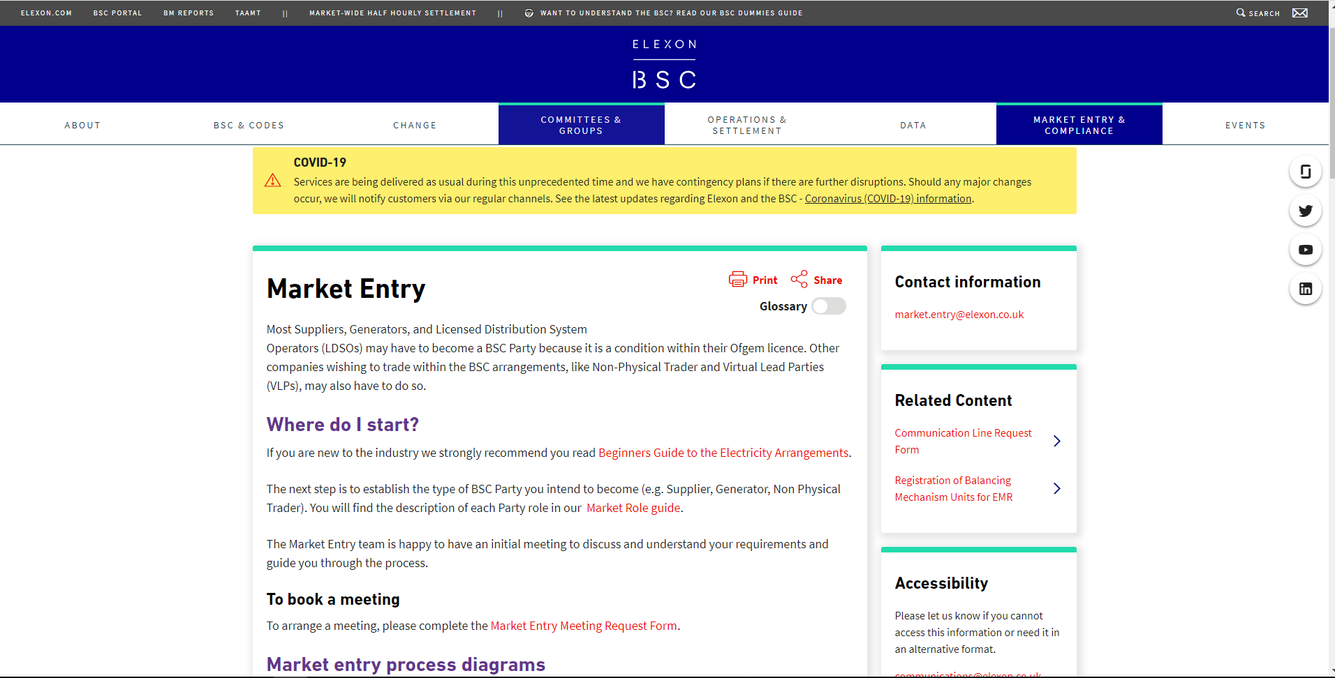
Slide 12: Contact details and links
Contact for Market Entry:
Market.entry@elexon.co.uk
Contact for Qualification:
Qualification@elexon.co.uk
Market Entry:
https://www.elexon.co.uk/reference/market-entry/
TERRE and Wider Access:
https://www.elexon.co.uk/about/trading-electricty-market/terre-wider-access/
BSC For Dummies:
https://www.elexon.co.uk/bsc-and-codes/bsc-guide-how-balancing-and-settlement-works/

