Slide 1
Imbalance Settlement
David Thomas
Delivery Lead
7 October 2020

Slide 2
Agenda
In this session, we will cover:
Core Principles of Imbalance Settlement
Contracts and Trading
Collection and Allocation of Meter Reads
Electricity Balancing Mechanism
Imbalance Volume, Price and Charges
BSC Credit Cover and further information

Slide 3
Core Principles of
Imbalance Settlement

Slide 4
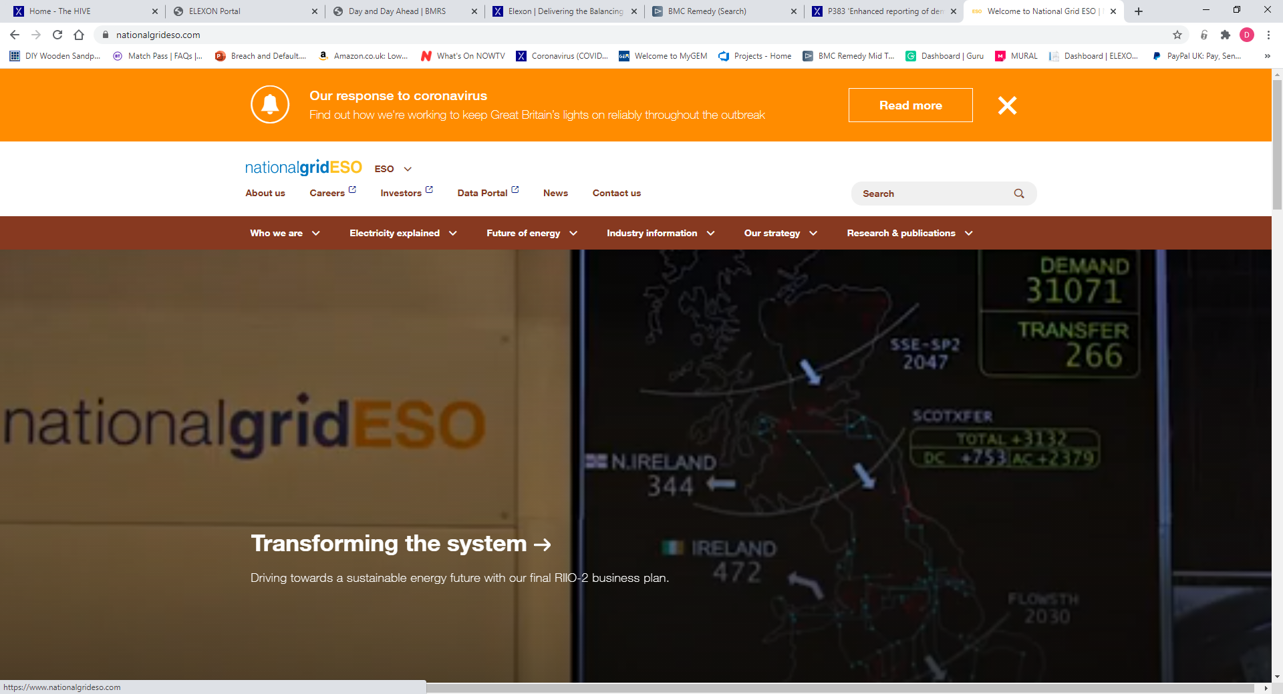

National Grid and Elexon
Grid Code (GC)
Physical Balancing
Balancing physical Generation and
Demand on the Network
Balancing and Settlement Code (BSC)
Imbalance Settlement
Calculates imbalances and charges/pays
Parties accordingly

Slide 5
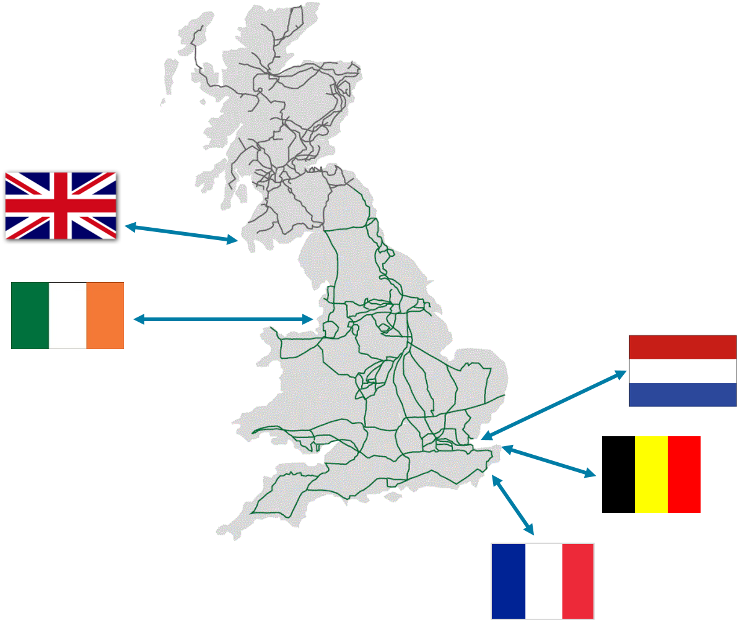
Transmission Network

Slide 6
Distribution Network
North Scotland
South Scotland
Northern
North Western
Yorkshire
Merseyside & North Wales
East Midlands
Midlands
Eastern
South Wales
London
South Western
South Eastern
Southern

Slide 7
Distribution Network
_P
_N
_F
_G
_M
_D
_B
_E
_A
_K
_C
_L
_J
_H

Slide 8
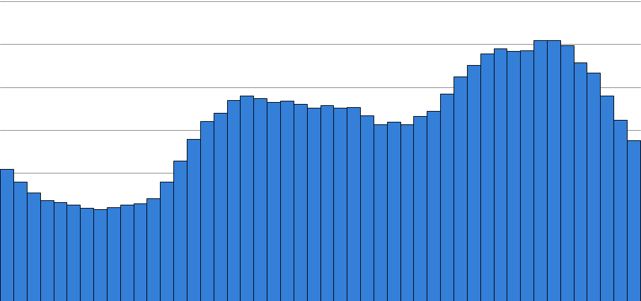
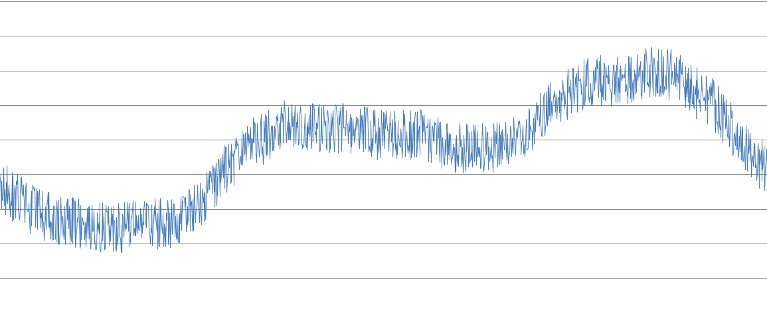
Introduction – Settlement Data
What are Settlement Periods?
  Standard time format used in Settlement (i.e. volumes are per Settlement Period)
  30 minute period, also known as half-hour (HH)
  48 Settlement Periods in a day (excluding clock change days which have 46/50)
Volume (MWh)

Slide 9
Concept of Imbalance
Elexon accounts and settles mismatches between
BSC Parties contracted and metered positions
National Grid Balancing Mechanism
Metered volumes collected and sent to ELEXON
Difference between metered and contracted volumes is Party’s imbalance
Imbalance volumes settled at Imbalance Price
Parties notify contract volumes to Elexon
Settlement Period (SP)

Slide 10
Contracts and Trading

Slide 11
Energy Contracts
Elexon capture the contracted volumes from Generators and Suppliers to see
what they have bought or sold to try and balance their position
Gate Closure
1 hour before start of Settlement Period
Submission Deadline
Before start of Settlement Period
Parties notify
contract volumes
to ELEXON
1 HR
Parties notify contract volumes to ELEXON
Settlement Period (SP)
Since November 2017, Parties can notify ELEXON of contracts anytime up to the start of a Settlement Period

Slide 12

Bilateral Contracts
An energy contract is a bilateral contract between Generator and Supplier
Submitted to ELEXON by:
    Dedicated ‘High Grade’ Communications Line
    ‘Low Grade’ web connection
    ‘ECVAA Web Service’ (EWS)

Slide 13
Contract Notifications
Trading Party 1 Account
Contract Volume Details
Energy Contract Volume Notification Agent (ECVNA)
Elexon Systems
Bilateral Contract
Trading Party 2 Account
Contract Volume Details

Slide 14


Contract Notifications
Trading Party 1 Account
Contract Volume Details
Power Exchange
Elexon Systems
Trading Party 2 Account
Contract Volume Details

Slide 15
National Grid and Elexon
Forward Contract Report
Released 4 times per day
Reference: ECVAA-I022
Provides forward view of Settlement Period contract position for all acknowledged energy contracts
Covers 7 Settlement Days following the
Settlement Day on which the report is provided
End of Day Report
Released ~2am D+1
Reference: ECVAA-I014
Summarises the energy contract volumes (ECVNs)
and metered volume reallocations (MVRNs)
for the last Settlement Day
Provides period and cumulative indebtedness data
and identifies Parties in Credit Default

Slide 16
Metering Collection and Allocation

Slide 17
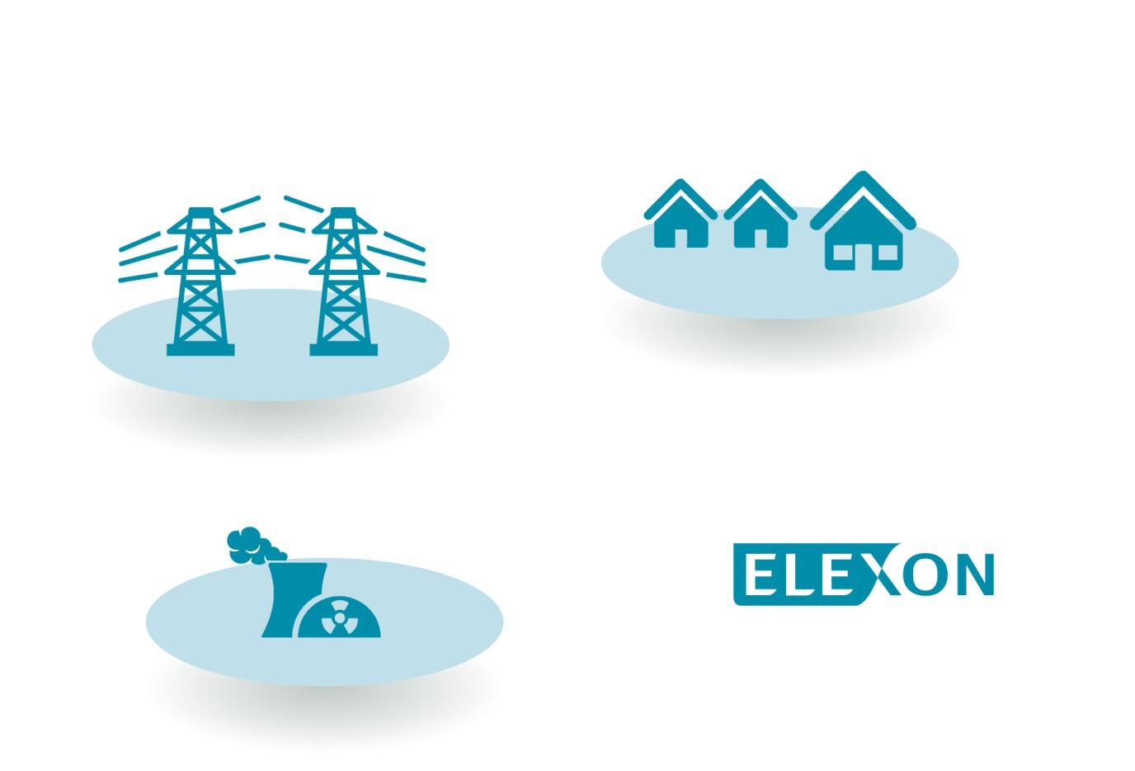

Collection of metered data
Elexon systems capture metered data to understand who consumed or generated energy during the Settlement Period
Generators
Grid Supply Points
(GSPs)
Suppliers
Imbalance Settlement

Slide 18
Balancing Mechanism Units (BMUs)
Sites that are directly connected to the Transmission System
T_NAME-1
Meter Point
Sites that are embedded into the Distribution System
E_NAME-1
Meter Point
I_IBD_NAME
Meter Point
Sites that are related to an Interconnector
I_IBG_NAME
Meter Point
Sites that are within Supplier BM Units and offer flexibility services
V_NAME-1
Meter Point

Slide 19
Supplier Base BM Units
Suppliers have 14 BM Units as default – one per GSP Group
2__ANAME000
Aggregated data from meter points
All Meter points in GSP Group A
Aggregated data from meter points
All Meter points in GSP Group B
2__BNAME000
2__CNAME000
Aggregated data from meter points
All Meter points in GSP Group C

Slide 20
Metered Energy Volumes
Aggregated data from meter points
Aggregated data from meter points
Meter Point
Meter Point
Meter Point
T_NAME-1
E_NAME-1
2__ANAME000
2__BNAME000
Generators
Grid Supply Points
(GSPs)
Suppliers

Slide 21
Party Accounts
BSC Party
Production
Account
Consumption Account
E_BMU
T_BMU
2__ABMU
2__BBMU
…
Meter Point
Meter Point
Aggregated data from meter points
Aggregated data from meter points

Slide 22
Metered Volume Reallocation Notification (MVRN)
BSC Party 1
BSC Party 2
Production Account
Consumption Account
Production Account
MVRN
T_BMU
2__ABMU
2__BBMU
E_BMU
Move a fixed MWh volume or % of volume, to 1 or more Parties
From P Account to P Account, or from C Account to C Account

Slide 23
Electricity Balancing Mechanism

Slide 24
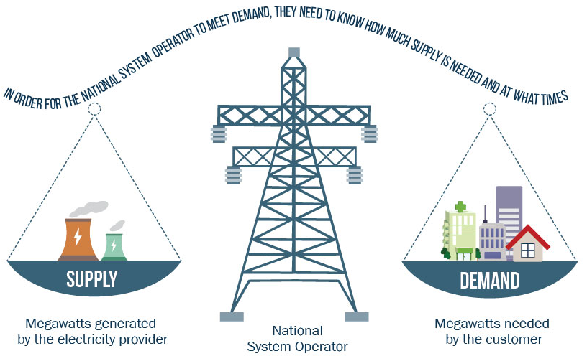
What is the Balancing Mechanism?
National Grid provides data on actions taken to balance the System

Slide 25
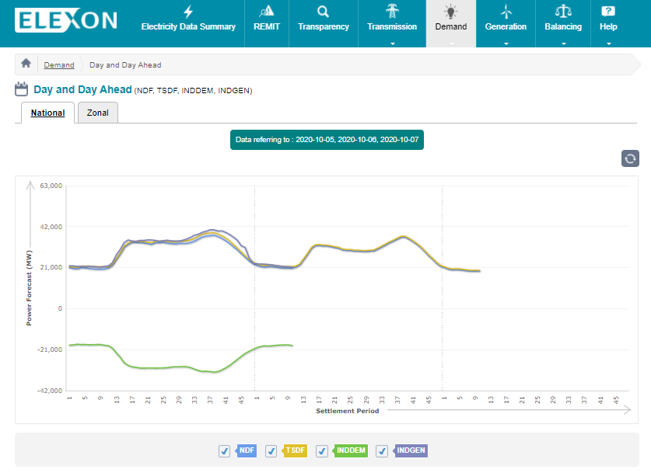
Forecast National Demand
National Grid’s demand forecast indicates how much energy will be needed for each HH
They can then compare this to the generation planned to be dispatched

Slide 26
Physical Notifications (PN)
Initial Physical Notification (IPN)
  Expected operating levels throughout the whole day for each BM Unit
  Submitted by 11.00 day ahead
Final Physical Notification (FPN)
  Expected operating level for Settlement Period for each BM Unit
  Submitted by Gate Closure

Slide 27
Bids and Offers
Bids and Offers are a BSC Party’s willingness to operate the BM Unit
differently to their FPN.
Offer to increase energy to
the system
  Increase generation or decrease demand
Bid to remove energy from
the system
  Decrease generation or increase demand
Offer
Bid

Slide 28
Bid/Offer Submission
A Bid/Offer submission from a Generator with an FPN of 300MW would look like this…
500MW
£50/MWh
Offers
400MW
£30/MWh
300MW
FPN
Energy
200MW
-£15/MWh
Contracted Sales
Bids
100MW
-£20/MWh
Time

Slide 29
Bid/Offer Submission
National Grid accept an Offer, so the Generator increases their generation output to 450MW…
50MW @ £50/MWh
100MW @ £30/MWh
500MW
£50/MWh
Offers
400MW
£30/MWh
300MW
FPN
Energy
200MW
-£15/MWh
Contracted Sales
Bids
100MW
-£20/MWh
Time

Slide 30
Bid/Offer Submission
National Grid accept a Bid, so the Generator decreases their generation output to 220MW…
500MW
£50/MWh
Offers
400MW
£30/MWh
80MW @ -£15/MWh
300MW
FPN
Energy
200MW
-£15/MWh
Contracted Sales
Bids
100MW
-£20/MWh
Time

Slide 31
Imbalance Volume and Price

Slide 32
Imbalance Volume
Elexon takes the Imbalance Volume and multiplies this by the Imbalance Price
to calculate the Imbalance Charge
Imbalance Volume
Metered Volumes
Accepted Balancing Actions
Contracted Volumes

Slide 33
Imbalance Position
PARTY IS LONG
  Is paid for the ‘surplus’ imbalance at System Price
  For a Generator: Volume generated > Volume sold
  For a Supplier: Volume consumed < Volume bought
PARTY IS SHORT
  Pays for the ‘deficit’ imbalance at System Price
  For a Generator: Volume generated < Volume sold
  For a Supplier: Volume consumed > Volume bought

Slide 34
Imbalance Position Example
BSC Party
Contract to sell 100MWh
Contract to buy
200MWh
Contracted Volumes
Account Level
Power stations generated 90MWh in total
Total customers consumption 180 MWh
BM Unit Level
Metered Volumes
+10 MWh
- 10MWh
+ 20MWh
Imbalance Volumes

Slide 35
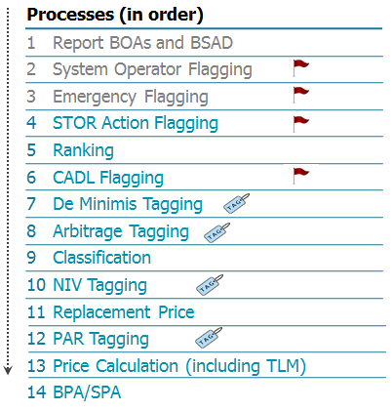
Single Imbalance Price
1
1
OFFER
250 MWh at £45/MWh
BID
300 MWh at £35/MWh
1
1
OFFER
250 MWh at £55/MWh
BID
30 MWh at £20/MWh
1
1
OFFER
50 MWh at £100/MWh
BID
0.5 MWh at £40/MWh
1
OFFER
20 MWh at £95/MWh
£/MWh

Slide 36
Imbalance Charge
Elexon calculate a single imbalance price for a given half hour
Balancing Actions taken by National Grid are included in the calculation of the imbalance price
Imbalance Volume
Imbalance Price
Imbalance Charge
Imbalance Charge
X
=

Slide 37
Trading Charges and Credit Cover

Slide 38

Your Invoice – Trading Charges
Energy Imbalance Cashflow
BM Unit Cashflow
BM Unit
Non-Delivery Charge
Residual Cashflow Reallocation Cashflow (RCRC)

Slide 39
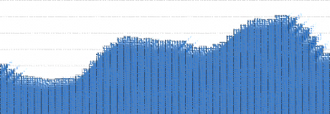


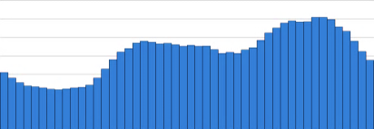


Data Reconciliation
What’s a Settlement Run?
A ‘snapshot’ of available data for a day after the event
With each Settlement Run, the accuracy of the data should improve
?
Settlement Day
+5 WD
+290 WD
(≈14 months)
+18 WD...

Slide 40
Settlement Timetable
Settlement Calendar
Available on the ELEXON Portal (www.elexonportal.co.uk)
Settlement Run | ID | Working Days | NHH Performance | HH Performance
Interim Information Run | II | 5 | N/A | 99%
Initial Settlement Run | SF | 18 | N/A | 99%
1st Reconciliation Run | R1 | 37 | 30% | 99%
2nd Reconciliation Run | R2 | 82 | 60% | 99%
3rd Reconciliation Run | R3 | 152 | 80% | 99%
Final Reconciliation Run | RF | 290 | 97% | 99%
Dispute Reconciliation Run | DF | 595 | N/A | N/A
For information only
Billable

Slide 41
Concept of Imbalance
Elexon capture the contracted volumes from Generators and Suppliers so we can see what they have bought or sold to try and balance their position
Settlement Period takes place
Elexon systems capture metered data to understand who consumed or generated energy during the Settlement Period
National Grid provides data on actions taken to balance the System
Elexon calculates the Imbalance Volume, multiplies this by the Imbalance Price,
to calculate the Imbalance Charge
BSC Parties will receive invoices for their Trading Charges

Slide 42
BSC Credit Cover
100%
Level 2 Default
Due to the settlement run timetable, an invoice for a settlement day is paid, on average, 29 calendar days after it occurs
Elexon therefore ask parties to lodge collateral to cover 29 calendar days of indebtedness
90%
Level 1 Default
80%
29 days Energy Indebtedness
Credit Cover

Slide 43
David.Thomas@elexon.co.uk
Elexon
7 October 2020

Slide 44
Imbalance Prices
Angus Fairbairn
Market Analyst
Angus Fairbairn
Market Analyst
7 October 2020
Notes:
This presentation is going to take you through the basics of imbalance pricing – the principles behind the pricing arrangements, the key terminology and an overview of how the prices are calculated and applied.
Unapologetic Beginner’s Guide – will provide links at end to further detail.

Slide 45
What you’ll take away
Imbalance Prices:
  When are Imbalance Prices used?
  What does Short and Long mean?
  Why are they so important?
  How are they calculated?
  Price calculation example.

Slide 46
Energy Imbalance Settlement
Elexon accounts for mismatches between BSC Trading Parties’ contracted and metered positions
  Parties notify energy contracts
  Metered volumes collected
  Difference is the Party’s imbalance volume
Imbalance volumes settled at ‘cash-out’ prices, ‘imbalance’ prices or ‘system’ prices
Notes:
To recap from this mornings imbalance settlement presentation…
The Process occurs as follows: the parties notify their energy contracts…
The imbalance volumes are then settled at …

Slide 47
‘Long’ or ‘Short’ terminology
Long Party
Short Party
  Is paid for the ‘surplus’ imbalance at Imbalance Price
  For a Generator: Volume generated > Volume sold
  For a Supplier: Volume consumed < Volume bought
  Pays for the ‘deficit’ imbalance at Imbalance Price
  For a Generator: Volume generated < Volume sold
  For a Supplier: Volume consumed > Volume bought
Notes:
During that presentation, I will often refer to short or long, refereeing either to Parties or system. Let’s get Imbalance Settlement terminology right… Could be different to trading terminologies.
When a party is long (‘surplus’ of energy) the price calculation is based on actions taken by National Grid to reduce generation or increase demand which is a BID
When a party is short (so there's a deficit of energy) then National Grid takes actions to increase generation or reduce demand which is an OFFER

Slide 48
‘Long’ or ‘Short’ terminology
Long System
Short System
  Generation > consumption
  National Grid takes actions to reduce the level of energy on the system (Bids)
  Consumption > generation
  National Grid takes actions to increase the level of energy on the system (Offers)
48
Notes:
During that presentation, I will often refer to short or long, refereeing either to Parties or system. Let’s get Imbalance Settlement terminology right… Could be different to trading terminologies.
When a party is long (‘surplus’ of energy) the price calculation is based on actions taken by National Grid to reduce generation or increase demand which is a BID
When a party is short (so there's a deficit of energy) then National Grid takes actions to increase generation or reduce demand which is an OFFER

Slide 49
When are they applied - Long Party example
Generating more than the contracted volume…
Bilateral Contract | 75 MWh
Generation volume | 100 MWh
Bilateral contract | 75 MWh
MWh
Actually generated
Bilaterally contracted
Notes:
This is an example illustrating when a party is long. So the party have Bilateral contract of 75 MWhs (hence they’ve sold 75 MWh) but they’ve generation 100MWh so here generation is more than what they have sold. Hence there will be a surplus of energy left over after the trading takes place

Slide 50
When are they applied - Long Party example
Generating more than the contracted volume…
Bilateral contract | 75 MWh
Generation volume | 100 MWh
MWh
Imbalance Volume
‘surplus’
Long imbalance position | 25 MWh
Energy Imbalance Cashflow | +25 MWh * Imbalance Price
Long imbalance position | 25 MWh
Notes:
This surplus of energy is 25 MWhs, which will be sold at the Imbalance Price. So 25 multiplied by the Imbalance Price

Slide 51
When they are applied - Short Party example
Generating less than the contracted volume…
Bilateral Contract | 75 MWh
Generation volume | 75 MWh
Bilateral contract | 100 MWh
MWh
Bilaterally contracted
Actually generated
Notes:
This example is illustrating when a party is short. So here the party has a bilateral contract of 100 MWh (essentially sold 100MWh) But they’ve generated only 75 MWhs
So there is a deficit of energy on the system and hence the party is short

Slide 52
When they are applied - Short Party example
Generating less than the contracted volume…
Bilateral contract | 100 MWh
Generation volume | 75 MWh
MWh
Imbalance Volume
‘deficit’
Long imbalance position | 25 MWh
Energy Imbalance Cashflow | -25 MWh * Imbalance Price
Short imbalance position | -25 MWh
Notes:
The deficit of energy is -25 MWh which the party will need to pay for at the Imbalance Price
The price to paid will be -25 MWh multiplied by the Imbalance Price at that particular settlement period

Slide 53
Why do we have Imbalance Cashflow?
Imbalance Volume
‘deficit’
Imbalance Volume
‘surplus’
The energy deficit is still used by customers
The energy has to be produced from a different source
The Party must pay a fair price
The energy surplus is still generated
The energy is used by end consumers
The Party must be paid a fair price
The Imbalance Price represents the cost of this energy

Slide 54
Why are Imbalance Prices important?
£2,242/MWh
£21/MWh

Slide 55
Why are Imbalance Prices important?
Applying 4 March 2020 Imbalance Prices to our Short Party example:
Settlement Period | 15 | 37
Imbalance Volume | -25MWh | -25MWh
Imbalance Price | £21/MWh | £2,242/MWh
Imbalance Cashflow | -£525 | -£56,050

Slide 56


Where does the imbalance cashflow go?
For Settlement Period 37 on 4 March 2020:
Short Parties
paid
Long Parties were paid
Left over
£840K
£9.7M
RCRC REDISTRIBUTED
£8.9M
Any ‘left over’ money after all the Energy Imbalance Cashflow for a Settlement Period is settled, is either credited or charged to active market participants

Slide 57
How are they calculated?
Notes:
Before I move onto the next section of the presentation does anybody have any questions

Slide 58
How are they calculated?
We will cover:
  Bids & Offers
  System Vs. Energy balancing actions
  Flagging and Tagging processes (these remove or reprice Bids/Offers accepted by National Grid)
  Simplified Working Example
Notes:
In this section of the presentation we will recap the balancing mechanism
We will go through system vs energy balancing actions
The flagging and tagging process
And an example to tie everything together

Slide 59
The Balancing Mechanism
Imbalance Prices are calculated based on the cost incurred by National Grid to balance the system using the Balancing Mechanism
It is based on the price of Bids and Offers that National Grid accepts for a Settlement Period
Notes:
National Grids job is to balance the system using Bids and Offers. The imbalance price is then based on the cost of national grid to do this.

Slide 60
How are they calculated - Bids and Offers
Used by National Grid to balance the system as part of the Balancing Mechanism
Bids and Offers are a Party’s willingness to deviate from their expected position
Bid
to reduce the level
of energy on the system:
Party pays (or paid) to
↓ generation or
↑ demand
Offer
to increase the level of energy on the system:
Party paid to
↑ generation or
↓ demand
Notes:
During the morning presentation, we mentioned Bids and Offer, they are Parties’ willingness to adjust their levels of output from FPN (Final Physical Notification) at a certain price.
National Grid accepts bids/offers in via Balancing Mechanism to help balance demand and generation on the System prior and in real time.
ELEXON will adjust Parties’ contracted position if they accepts any bids/offers to ensure they are not exposed to imbalance from bids/offers.

Slide 61
Trans European Replacement Reserves Exchange
TERRE actions are accepted in 15 minute blocks and are aggregated and incorporated into the pricing stack
Introduces two new balancing action types to our pricing stack
Volume of GB need met (VGB)
Volume of GB balancing energy need met by TERRE balancing volumes with a volume (MWh) and
the TERRE clearing price (£/MWh)
RR Aggregated Unpriced System Actions
(RRAUSS and RRAUSB)
Energy balancing volumes from TERRE that does not meet GB need with a volume (MWh) and a price of £0/MWh.
Notes:
During the morning presentation, we mentioned Bids and Offer, they are Parties’ willingness to adjust their levels of output from FPN (Final Physical Notification) at a certain price.
National Grid accepts bids/offers in via Balancing Mechanism to help balance demand and generation on the System prior and in real time.
ELEXON will adjust Parties’ contracted position if they accepts any bids/offers to ensure they are not exposed to imbalance from bids/offers.

Slide 62
Ranking actions in merit order
Rank Offers and Bids separately by price to create our Pricing Stack
Offers
  National Grid pay to increase the level of energy
Bids
  National Grid are paid to decrease the level of energy
  (where the price is negative National Grid Pay)
£100/MWh
Most expensive
£30/MWh
Least expensive
£10/MWh
£70/MWh
£0/MWh
£50/MWh
£40/MWh
Least expensive
-£40/MWh
Most expensive

Slide 63
How are they calculated - Energy versus system balancing
Imbalance Prices are calculated based on the price of Bids and Offers that National Grid accept to balance the system.
The SO (National Grid) takes both energy balancing actions and system balancing actions
Only energy balancing actions will be included in the Imbalance Price calculation
Energy balancing actions
System balancing actions
    Actions taken to maintain gross national half-hourly energy balance
    To match Supply with Demand
    Market-driven imbalances
    Costs are reflected in the Imbalance Price
    To manage constraints on the network
    Actions taken to balance the system geographically and/or for shorter term balancing, e.g. frequency control
    Non-market driven imbalances
Notes:
Specifically the Imbalance Prices are intended to reflect the costs of balancing imbalances in Party’s energy accounts.
However, National Grid accept actions from Parties to balance the system because of constraints too.
System constraints are caused because the transmission is a physical network with limited capacity. We have a single price zone in GB – so physical constraints are stripped out. Therefore, in addition to balancing the overall levels of supply and demand, National Grid must also balance the use of the network geographically to avoid system faults.
Because the Imbalance Prices are intended to reflect the costs of balancing the overall levels of energy supply and demand, the Main Price calculation seeks to exclude or at least limit the impact of System Actions.
When balancing the system national grid take both system and energy balancing actions. However we do not use all balancing actions in the same way since national grid doesn’t take all balancing actions for the same reasons. Some actions are taken purely to balance the half hourly energy imbalance of the Transmission System. (these are called energy balancing actions) But some actions, system balancing actions are taken for non energy reasons and they are simply taken to manage the system. The purpose of the imbalance price calculation is to remove system balancing as they could distort the imbalance price.

Slide 64
How are they calculated – Tagging and Flagging
Tagging
Flagging
To remove volumes of actions we don’t want in the calculation
To prevent some actions from distorting the price
Does not remove volume
Flagged actions may be re-priced
Notes:
Specifically the Imbalance Prices are intended to reflect the costs of balancing imbalances in Party’s energy accounts.
However, National Grid accept actions from Parties to balance the system because of constraints too.
System constraints are caused because the transmission is a physical network with limited capacity. We have a single price zone in GB – so physical constraints are stripped out. Therefore, in addition to balancing the overall levels of supply and demand, National Grid must also balance the use of the network geographically to avoid system faults.
Because the Imbalance Prices are intended to reflect the costs of balancing the overall levels of energy supply and demand, the Main Price calculation seeks to exclude or at least limit the impact of System Actions.

Slide 65
How are they calculated – Tagging and Flagging
DMAT tagging
(De Minimis Acceptance Threshold) – Removing actions less than 0.1MWh
CADL flagging (Continuous Acceptance Duration Limit) – actions less than 15 minutes
Arbitrage tagging – removing actions which wouldn’t have happened in an efficient market
Tagging
(removes volumes)
Flagging
(prevent distortion)
SO flagging (System Operator) – physical constraint related actions
NIV tagging (Net Imbalance Volume) – to determine overall imbalance
STOR Provider flagging (Short Term Operating Reserve) – actions from STOR plants
PAR tagging (Price Average Reference) – ‘marginal’ price. Only keep the 1MWh most expensive actions.
Notes:
As well as understanding the difference between energy-balancing actions and system-balancing actions there are some other key parameters used in the Main Price calculation.
At the end of the calculation, a Buy Price Adjustment (BPA) is added when the system is short and the Sell Price Adjustment (SPA) is added when the system is long. Part of BSAD. Reflects long-term bilateral contracts between National Grid and Parties outside the BSC (e.g. to provide reserve generation under STOR or ‘run warm’ under BM Start-Up).
Note that CADL, DMAT and PAR set by the BSC Panel and are the same for each Settlement Period. BPA/SPA set by National Grid for each Settlement Period.

Slide 66
How are they calculated – Flagging
CADL flagging – currently actions less than 10 minutes. Was reduced from 15 minutes 1 April 2019.
Actions potentially
re-priced downwards for the price calculation
Flagging
(prevent distortion)
SO flagging – physical constraint related actions
STOR Provider flagging – actions from STOR plant
Actions potentially
re-priced upwards for the price calculation
Notes:
As well as understanding the difference between energy-balancing actions and system-balancing actions there are some other key parameters used in the Main Price calculation.
At the end of the calculation, a Buy Price Adjustment (BPA) is added when the system is short and the Sell Price Adjustment (SPA) is added when the system is long. Part of BSAD. Reflects long-term bilateral contracts between National Grid and Parties outside the BSC (e.g. to provide reserve generation under STOR or ‘run warm’ under BM Start-Up).
Note that CADL, DMAT and PAR set by the BSC Panel and are the same for each Settlement Period. BPA/SPA set by National Grid for each Settlement Period.

Slide 67
SO and CADL flagging
SO and CADL flagged actions are potentially repriced downwards. There are three stages to the flagging:
SO and CADL Flagged actions are initially considered Stage 1 Flagged
Classification assess the price of the Stage 1 flagged action against the price of the most expensive unflagged action
Stage 2 Flagged actions are re-priced as the same price as the most expensive unflagged action – called the replacement price
CADL Flagging – actions less than 10 minutes
SO Flagging – physical constraint related actions
Flagging
To prevent some actions from distorting the price
Flagged actions may be re-priced

Slide 68
SO and CADL Flagged actions
Ranked Offers
Most
expensive
Stage 1 Flag
SO Flag
SO and CADL Flagged actions are initially considered Stage 1 Flagged
Stage 1 Flag
CADL Flag
Least
expensive
Most
expensive
Ranked Bids

Slide 69
SO and CADL Flagged actions
Classification assess the price of the Stage 1 flagged action against the price of the most expensive unflagged action
    If the Stage 1 Flagged action is less expensive the action loses its flag and keeps its price.
    If the Stage 1 flagged action is more expensive then the action becomes Stage 2 Flagged and loses it price.
After DMAT and Arbitrage tagging
Ranked Offers
Most
expensive
Stage 1 Flag
Stage 2 Flag
Stage 1 Flag
  Most expensive unflagged action
Stage 1 Flag
Flag removed
Stage 1 Flag
Least
expensive
Most
expensive
Ranked Bids

Slide 70
SO and CADL Flagged actions
After DMAT and Arbitrage tagging
After NIV tagging
Ranked Offers
Most
expensive
    Stage 2 Flagged actions are re-priced as the same price as the most expensive unflagged 1MWh
Stage 1 Flag
Stage 2 Flag
Stage 1 Flag
Replacement Price applied
Stage 2 Flag
  Replacement Price
Stage 1 Flag
Flag removed
Stage 1 Flag
Stage 1 Flag
Least
expensive
Most
expensive
Ranked Bids

Slide 71
Price Calculation Example
Notes:
Now for the Main Price, which is based on NG balancing actions…

Slide 72



Price calculation steps
Processes (in order)
Report BOAs and BSAD
System Operator flagging
Emergency flagging
STOR Action flagging
Ranking
CADL flagging
De Minimis tagging
Arbitrage tagging
Classification
NIV tagging
Replacement Price
PAR tagging
Price Calculation (including TLM)
BPA/SPA
Notes:
National Grid takes care of the two first steps, removing the system-balancing actions, and ELEXON undertakes the remaining stages of the calculation, including….
Emergency Instructions can feed in as BOAs or be tagged out as system-balancing.
Arbitrage tagging - actions which have no effect on the energy balancing of the system but lead to an overall financial benefit for the System Operator.
NIV tagging: Separate Buy and Sell action stacks which are then netted off, leaving either a net volume of Buy actions or a net volume of Sell actions. This is the Net Imbalance Volume or NIV (Excess of Offers => system short=> NIV negative when and Excess of Bids => system long=> NIV positive).

Slide 73
1. Receive all balancing actions
Accepted Bids and Offers
Balancing Services Adjustment Actions (BSAA, actions taken outside the Balancing Mechanism)
Demand Control volumes (priced at Value of Lost Load, £6,000/MWh)
1
OFFER
250 MWh at £45/MWh
BID
-30 MWh at £35/MWh
OFFER
250 MWh at £55/MWh
BID
-30 MWh at £20/MWh
OFFER
50 MWh at £100/MWh
BID
-0.05 MWh at £40/MWh
OFFER
20 MWh at £95/MWh
OFFER
20 MWh at £1,000/MWh
Notes:
Value of Lost Load (VoLL) is an administrative value to reflect customers security of supply (ie the ‘price of disconnections’). It is currently set at £3,000/MWh
Supplementary balancing reserve (SBR) and DSBR would also be included at VoLL

Slide 74
2. Rank the actions
OFFER
20 MWh at £1,000/MWh
Most expensive
Offer stack
OFFER
50 MWh at £100/MWh
Offers and Bids are separately ranked from the least to the most expensive
OFFER
50 MWh at £95/MWh
OFFER
250 MWh at £55/MWh
OFFER
250 MWh at £45/MWh
Least expensive
BID
-0.05 MWh at £40/MWh
Least expensive
Bid stack
BID
-30 MWh at £35/MWh
BID
-30 MWh at £20/MWh
Most expensive

Slide 75

3. Remove De Minimis and Arbitraged actions
OFFER
20 MWh at £1,000/MWh
OFFER
50 MWh at £100/MWh
De Minimis and arbitrage actions are ‘tagged’ and removed from the stack
OFFER
50 MWh at £95/MWh
OFFER
250 MWh at £55/MWh
OFFER
250 MWh at £45/MWh
BID
-0.05 MWh at £40/MWh
Less than De Minimis Acceptance Threshold (DMAT) (0.1 MWh)
*please note April 2019 change
BID
-30 MWh at £35/MWh
BID
-30 MWh at £20/MWh

Slide 76
4. NIV Tagging
OFFER
20 MWh at £1,000/MWh
BID
-30 MWh at £35/MWh
590 MWh
Minus
60 MWh
OFFER
50 MWh at £100/MWh
BID
-30 MWh at £20/MWh
10
= 590 MWh
OFFER
20 MWh at £95/MWh
OFFER
250 MWh at £55/MWh
The smaller stack of Bids is subtracted from the most expensive Offers
OFFER
250 MWh at £45/MWh
BID
-30 MWh at £35/MWh
BID
-30 MWh at £20/MWh
= -60 MWh
NIV = Volume of Offers – Volume of Bids
= 590MWh – 60MWh
= 530MWh
Notes:
To determine the overall imbalance

Slide 77
5. NIV Tagging
OFFER
10 MWh at £100/MWh
OFFER
20 MWh at £95/MWh
NIV = 530 MWh
OFFER
250 MWh at £55/MWh
OFFER
250 MWh at £45/MWh
Where NIV > 0 then the System is SHORT (More Offers than Bids)
Where NIV < 0 then the System is LONG (More Bids than Offers)

Slide 78
6. Flagging and the Replacement Price
UNFLAGGED OFFER
10 MWh at £95/MWh
SO FLAGGED OFFER
10 MWh at £100/MWh
OFFER
10 MWh at £100/MWh
95
Replacement Price (£95/MWh)
(set by RPAR, the most expensive 1MWh of unflagged actions)
OFFER
20 MWh at £95/MWh
Most expensive unflagged action – ie ‘pure energy action’
UNFLAGGED OFFER
250 MWh at £55/MWh
OFFER
250 MWh at £55/MWh
SO FLAGGED OFFER
250 MWh at £55/MWh
OFFER
250 MWh at £45/MWh
Notes:
Flagged actions are potentially system balancing – but still part of the NIV
SO flagging for locational constraint
Only want to re-price flagged actions where they would distort the price

Slide 79
7. PAR Tagging and final price calculation
OFFER
10 MWh at £95/MWh
= PAR: 1 MWh
1
OFFER
20 MWh at £95/MWh
OFFER
250 MWh at £55/MWh
OFFER
250 MWh at £45/MWh
Imbalance Price is the volume weighted average price of the remaining actions
Adjusted for Transmission Losses – TLM (except for BSAAs)
Plus the Buy Price Price Adjuster (BPA) or Sell Price Price Adjuster (SPA)
$$System Price=£95/MWh$$
Notes:
Back to our simple example

Slide 80
Where to find out more

Slide 81
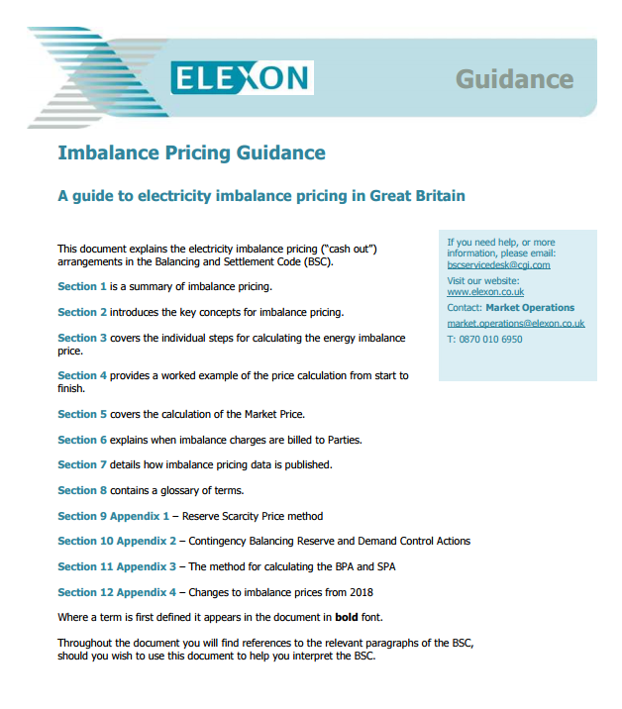
Want to know more?
https://www.elexon.co.uk/operations-settlement/balancing-and-settlement/imbalance-pricing/
Notes:
For anyone who wants to get into the detail of the calculation, we publish a comprehensive overview on our website. This also contains links to the actual calculations and rules in the BSC.

Slide 82
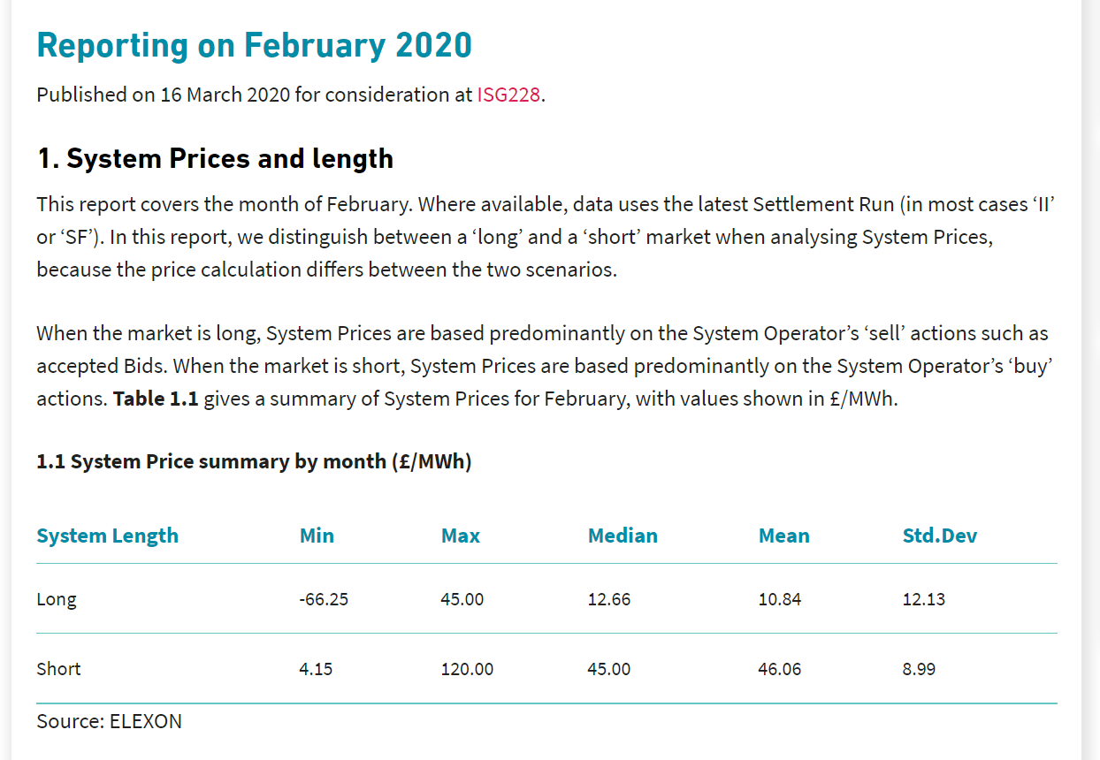
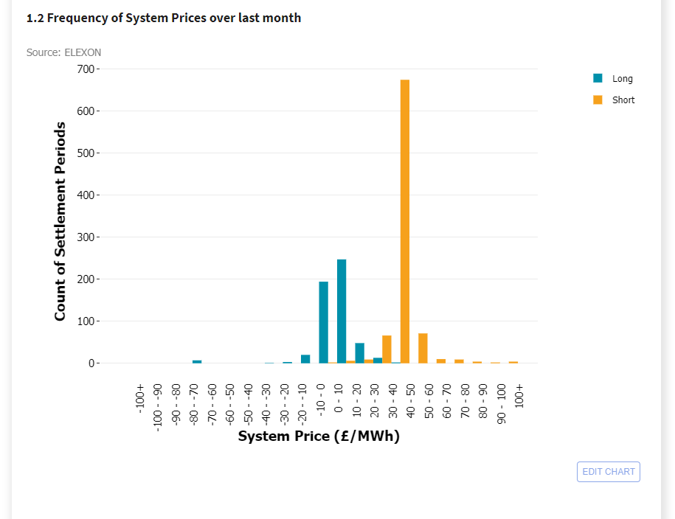
System Price Analysis Report (SPAR)
https://www.elexon.co.uk/data/key-data-reports/system-prices-analysis-report/

Slide 83
Still want to know more?
Balancing Mechanism Reporting Service – BMRS (www.bmreports.com)
  Live reporting – prices within 15 mins of end of Settlement Period
  Indicative prices as may not include all BSAD/BSAA data
  De-rated Margin and Loss of Load Probabilities (LoLPs)
ELEXON Portal (www.elexonportal.co.uk)
  Historic prices back to 2001 (‘Best View Prices’ spreadsheet)
  Published at D+1 and updated at each Settlement Run
  Dynamic Loss of Load Probability (LoLP) data

Slide 84
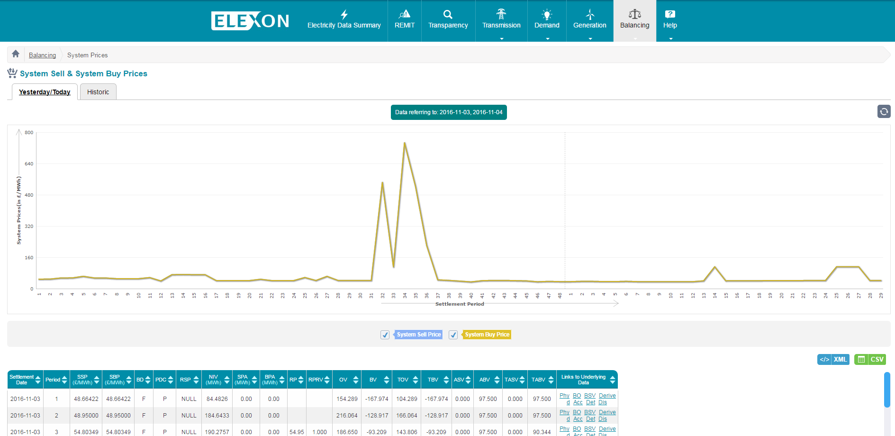
BMRS website (www.bmreports.com)
INDICATIVE ONLY AND SUBJECT TO CHANGE POST PUBLICATION
Not amended retrospectively

Slide 85
Angus.Fairbairn@elexon.co.uk
Elexon
7 October 2020

Slide 86
Supplier Volume Allocation (SVA)
Nick Baker
Product Analyst
7 October 2020

Slide 87
What are we going to cover in this presentation?
What is Supplier Volume Allocation (SVA)?
Types of meters and challenges with Settlement
Suppliers and the Supplier Hub
Non-Half Hourly Settlement
        - Introduction to Profiling
        - What EAC & AAs are, how they are calculated and used
GSP Group Correction Factor (GCF)
Settlement Process

Slide 88
Imbalance Settlement
Recap

Slide 89
Recap- Concept of Imbalance
Elexon accounts and settles mismatches between BSC Parties contracted and metered positions
National Grid Balancing Mechanism
Metered volumes collected and sent to Elexon
Difference between metered and contracted volumes is Party’s imbalance
Imbalance volumes settled at Imbalance Price
Parties notify contract volumes to Elexon
Settlement Period (SP)

Slide 90

Recap – What does ‘Imbalance’ mean?
And calculate payments where the two don’t match
Compare what a Generator agreed to sell…
With what a Generator actually produced…
And calculate payments where the two don’t match
Contracted
volumes
Metered
volumes
Compare what a Supplier agreed to buy…
With what a Supplier actually consumed…

Slide 91
Introduction to
SuppLier Volume AllOCation

Slide 92

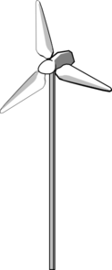
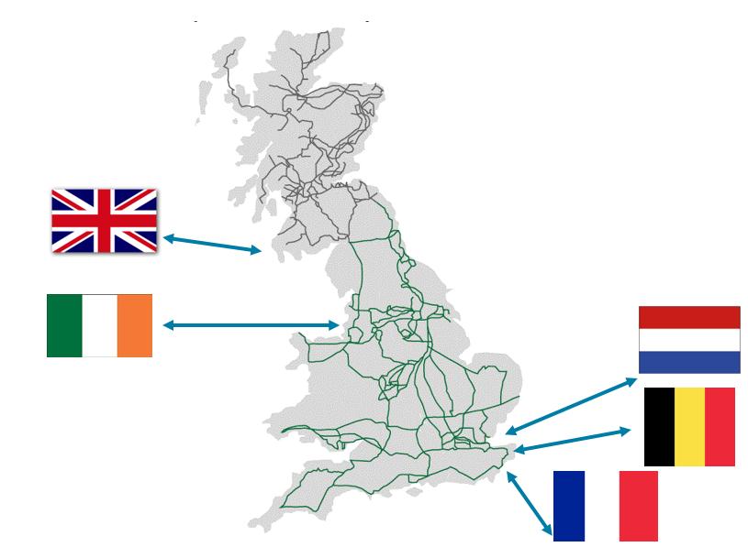
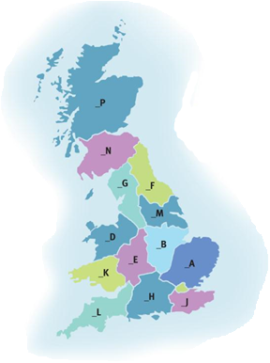


CVA and SVA
TRANSMISSION
NETWORK
CVA
Central Volume Allocation
“THE GRID”
Large Scale Supply
Large Scale Generation
Interconnectors
Grid Supply Point (GSP)
DISTRIBUTION
NETWORK
SVA
Supplier Volume Allocation
GSP Groups
Small Scale Supply
Small Scale Generation

Slide 93
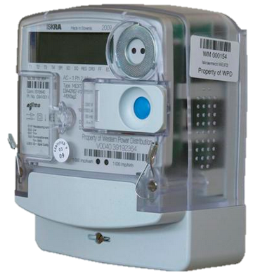
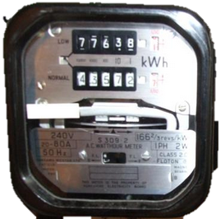
Metering – Half Hourly (HH) Vs Non-Half Hourly (NHH)
HH
NHH
Used in all CVA sites
Used in domestic households
Used in large industrial and commercial SVA sites
Used in small industrial and commercial sites
Records and stores energy flow volumes per half hour
Records energy flow continually and requires periodical meter reads
Easy to use in Settlement
Hard to use in settlement

Slide 94



Metering – Unmetered Supplies
We can manage small, predictable loads as
Unmetered Supplies
Street Lights
Traffic Signals
(e.g. traffic lights, belisha beacons)
Miscellaneous
(e.g. cable cabinets)
$≈$ 1% of total Settlement energy

Slide 95
Energy consumption Vs Number of customers
~340k HH customers
~124 TWh HH consumption
~31 million NHH customers
Notes:
****% of consumption figures
31 million
340,000 HH
51.5:47.5:1 (new- Sep-Aug 19-20)
50:49:1 (old)

Slide 96
Suppliers and the supplier HUB

Slide 97
What is a Supplier?
Owned Generation
SUPPLIER
Power Purchase Agreements (PPA)
Payment
Small scale supply
Billing
Wholesale Energy Market
Notes:
Supplier provides generation to customers
They source their generation from their own gen, ppa’s and the energy trading market
Re-coop the costs by billing

Slide 98
What is a Supplier?
Data Collector
Meter Operator
Data Aggregator
SUPPLIER
THE SUPPLIER HUB
Notes:
BSC is just one of many industry codes that puts obligations on Suppliers so appointing Supplier Agents should ensure they remain compliant.
Suppliers have to abide by minimum of 8 codes (MRA, BSC, CUSC etc.)
Must appoint agents in accordance with section J but they are responsible for the actions of their agents.
Section S of the BSC describes the obligations on Suppliers to provide data and ensure that Supplier Agents undertake the requirements defined for them.

Slide 99
Supplier Agent Roles
Meter Operator
(MOP)
Install and maintain meters
Provide Meter Technical Details to DC
Data Collector
(DC)
Collect and validate meter reads
Convert reads to annual values
Data Aggregator
(DA)
For each Supplier, group consumption together by a number of criteria

Slide 100
NHH Settlement: Part 1

Slide 101
NHH Settlement
What about the 30 million customers who only have NHH meters (which are read only a few times a year at most)?
How do we work out what they consumed in a given half hour (Settlement Period)?

Slide 102
What is a Load Profile?
A Load Profile represents the pattern of daily and annual electricity usage for the average customer in each one of the Profile Classes.
There are a number of variables that affect a demand profile such as:
Temperature
(different for
each GSP group)
Sunset time
Day of week
Public Holidays
Seasons
These are all considered when creating the Load Profiles from the sample consumption data.

Slide 103


Sample Profiling
1
2
3
Sample customers’ consumption…
Produce
profile data:
a typical half hourly usage pattern across a year
Apply to all similar customers
Notes:
Around 2,000 customers selected and specialist meters installed to monitor consumption.
Produce profile data based on their patterns and usage over a year
Apply to similar customers based on location, usage etc…

Slide 104
Profile Classes
Profile Class | Type of customer | Description | Example
1 | Domestic | Single/flat electricity rate 24x7 | Domestic premises
2 | Domestic | Multi–rate customers (typically Economy 7 – dual tariff: normal & night) | Domestic premises with switched load capability
3 | Non-Domestic (Commercial) | Single/flat electricity rate 24x7 | Small businesses
4 | Non-Domestic (Commercial) | Multi–rate customers (typically Economy 7 – dual tariff: normal & night) | Small businesses with switched load capability
Notes:
Following the implementation of P272, profile data is no longer collected for PC 5-8 (effectively redundant except for a de minimis amount)
Based on when the demand is used not just the volume.

Slide 105
What is a Load Profile?
A Load Profile represents the pattern of electricity usage by day and by year for the average customer in each one of the four Profile Classes.
Domestic (PC1)
Non - Domestic (PC3)
Annual
Tuesday
Sunday
Notes:
We produce seasonal profiles and profiles per day type which reflect British characteristics.
Here are 2 profile shapes, for domestic and non-domestic customer. One annual, One WD and One NWD.
We can see the Sunday ‘lunch’ tradition during noon, the 1st peak of the day compared to the relatively flat shape of commercial (non domestic) sites.
On a Tuesday we can see a typical profile shape for non-domestic customers, like small businesses, expanding along the working hours of the day, while for domestic customers small peak in the morning and then quite flat shape during the day when people are at work.

Slide 106
NHH Settlement: part 2

Slide 107
NHH Settlement
How can we aggregate all those consumers’ consumption when their meters are read at different times and cover different periods?
EACs and AAs

Slide 108
Settlement Consumption
Annualised Advance (AA)
Estimated Annual Consumption (EAC)
Annual rate of consumption derived by extrapolating a meter advance over a year using a profile
Forward looking estimate (weighted average of previous EAC and the new AA)
EAC
AA
1st Meter Reading
2nd Meter Reading
Notes:
AA- Advance between two reads used to create a yearly profile. (must be over 6 months for an accurate reflection)
EAC- forward estimate, uses AAs to weight the previous EAC.

Slide 109
NHH Data Aggregation (NHHDA)
Each Data Aggregator adds up EAC/AAs for customers with same…
Supplier
Profile Class (PC)
GSP Group
Line Loss Factor Class (LLFC)
Standard Settlement Configuration (SSC)
Time Pattern Regime (TPR)
This gives the Data Aggregator the estimated yearly demand for a ‘Super Customer’
Notes:
LLFC – how much electricity is lost on the network when it gets to that meter
SSC – type of meter (one rate, two rate etc.)
TPR – how the meter behaves at different times
The super customer can be used as a representative figure for each of the categories.

Slide 110
NHH Settlement
The role of a Profile is to turn annual values into HH values. To do this we use a profile coefficient.

Slide 111
NHH Settlement
Meter Advance
AA/EAC
AA
EAC
AA
EAC
EAC
AA
AA
EAC
EAC
AA
EAC
EAC
AA
Aggregated EACs/AAs for Supplier
‘Super Customer’
Period Profile Class Coefficient
X
HH estimate
Notes:
*****March 2018 as example
*************Change/simplify
Meter Advance = Meter Reading #2 – Meter Reading #1
AA = Meter Advance / sum(Daily Profile Coeficients)
Use AA and sum(Daily Profile Coefficients) to calculate EAC

Slide 112
Applying the Period Profile Class Coefficient
1
GSP Group _C
2
2
Customers of Supplier X Limited…
Aggregated annual
consumption of
2,000,000 MWh
Profile Class 1
LLF Class 100
SSC 0393
Notes:
Annual consumption for all customers grouped into these specifics is aggregated

Slide 113
Applying the Period Profile Class Coefficient
3
4
Settlement Period 14:30 to 15:00 on 17 July 2020
Period Profile Class Coefficient (PPCC) = 0.00006
Aggregated annual
consumption of
2,000,000 MWh
Period Profile Class Coefficient (PPCC) of 0.00006
X
=
customers are estimated to have used 120MWh during this Settlement Period
Notes:
And multiplied by the profile co-efficient for a given settlement period.
This provides an estimate to a supplier how much energy these customers will use.

Slide 114
GSP Group Correction

Slide 115
Grid Supply Point (GSP) Groups
North Scotland
14 host Distribution Networks take energy from the Transmission Network at defined Grid Supply Points.
These networks are also known as GSP Groups.
South Scotland
North Western
Northern
Merseyside & North Wales
Yorkshire
East Midlands
Midlands
South Wales
Eastern
London
South Western
South Eastern
Southern

Slide 116
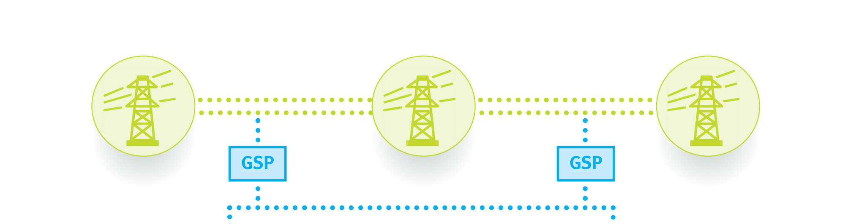

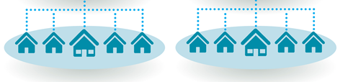
GSP Group take – top down and bottom up
What goes into the distribution region

Slide 117
GSP Group Correction
Using GSP meter reads, we work out what energy enters (or leaves) each Distribution Network per Settlement Period. This is called the Group Take.
GSP Group Correction Factors scale Suppliers’ volumes up or down, so that the total of the corrected volumes equals the GSP Group Take.
Any errors are effectively ‘smeared’ across Suppliers according to their market shares in that GSP Group and Settlement Period.

Slide 118
GSP Group Correction
Profile Build Up - Uncorrected
1800
1600
1400
1200
HH
Unmetered
MWh
1000
PC4
PC3
800
PC2
PC1
600
Group Take
400
200
0
1
2
3
4
5
6
7
8
9
10
11
12
13
14
15
16
17
18
19
20
21
22
23
24
25
26
27
28
29
30
31
32
33
34
35
36
37
38
39
40
41
42
43
44
45
46
47
48
Settlement Period

Slide 119
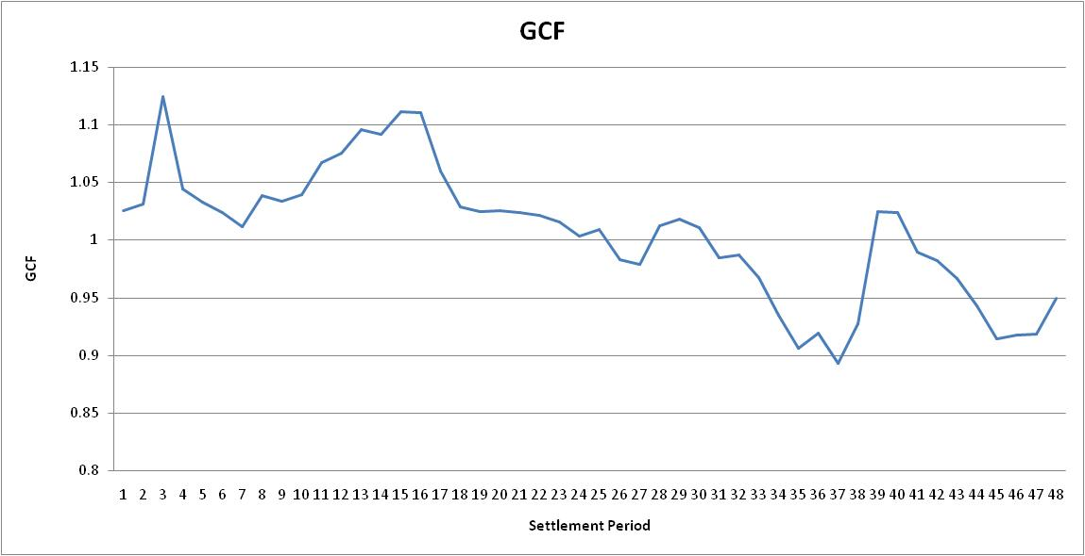
GSP Group Correction Factors

Slide 120
GSP Group Correction- What is it correcting for?
There are two main potential sources of error:
Profiling error
Some examples:
Sampling errors
National profiles applied to regional GSP Groups
Special days e.g Easter and Christmas
Volume error
Some examples:
Large EACs and AAs
Undetected theft

Slide 121
Settlement Process

Slide 122

SVA Settlement process

Slide 123
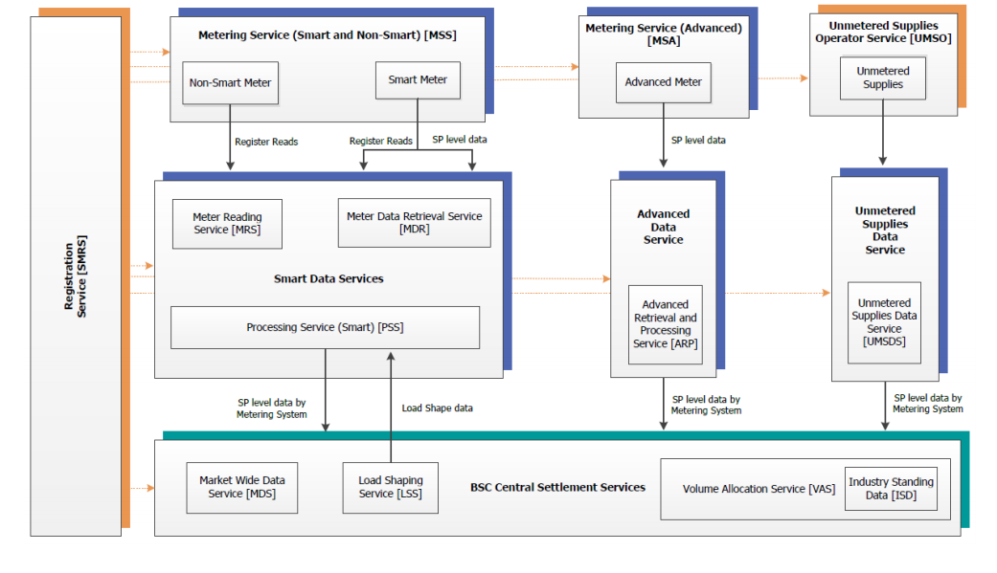
Future SVA Settlement process changes?
Ofgem’s Significant Code Review – Electricity Settlement Reform (https://www.ofgem.gov.uk/electricity/retail-market/market-review-and-reform/smarter-markets-programme/electricity-settlement-reform)
Market-wide HH Settlement

Slide 124
Settlement
BSC Party
Settlement Invoice
Energy Contracts
Production Account
Consumption Account
Credited Energy
E_BMU
T_BMU
2_ABMU
2_BBMU
Aggregated data from meter points
Aggregated data from meter points
Meter Point
Meter Point
Notes:
Invoice sent daily if <£500, otherwise wait until reach £500 or quarter
Need to balance each account separately

Slide 125
nick.baker@elexon.co.uk
ANY QUESTIONS?
020 7380 4337

