Slide 1
Supplier Volume Allocation (SVA)
Nick Baker
Product Analyst
8 October 2020

Slide 2
What are we going to cover in this presentation?
What is Supplier Volume Allocation (SVA)?
Types of meters and challenges with Settlement
Suppliers and the Supplier Hub
Non-Half Hourly Settlement
        - Introduction to Profiling
        - What EAC & AAs are, how they are calculated and used
GSP Group Correction Factor (GCF)
Settlement Process

Slide 3
Imbalance Settlement
Recap

Slide 4

Recap- Concept of Imbalance
Elexon accounts and settles mismatches between BSC Parties contracted and metered positions
National Grid Balancing Mechanism
Metered volumes collected and sent to Elexon
Difference between metered and contracted volumes is Party’s imbalance
Imbalance volumes settled at Imbalance Price
Parties notify contract volumes to Elexon
Settlement Period (SP)

Slide 5

Recap – What does ‘Imbalance’ mean?
And calculate payments where the two don’t match
Compare what a Generator agreed to sell…
With what a Generator actually produced…
And calculate payments where the two don’t match
Contracted
volumes
Metered
volumes
Compare what a Supplier agreed to buy…
With what a Supplier actually consumed…

Slide 6
Introduction to
SuppLier Volume AllOCation

Slide 7

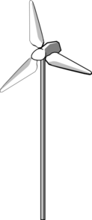
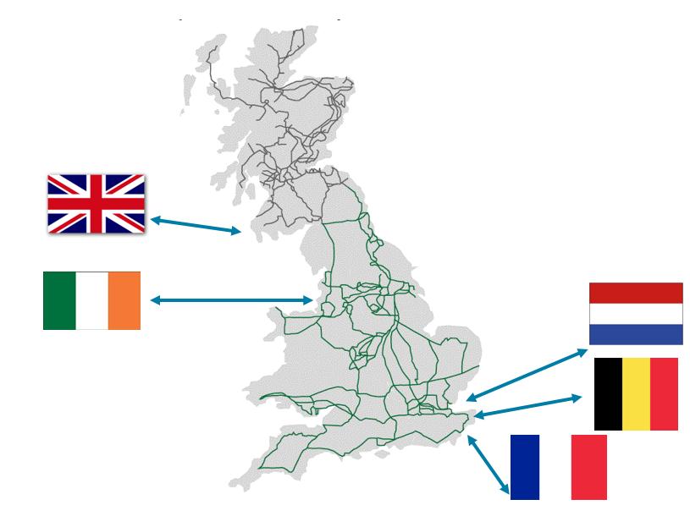
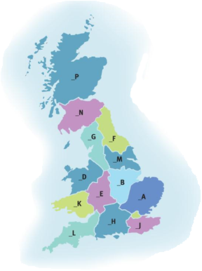


CVA and SVA
TRANSMISSION
NETWORK
CVA
Central Volume Allocation
“THE GRID”
Large Scale Supply
Large Scale Generation
Interconnectors
Grid Supply Point (GSP)
DISTRIBUTION
NETWORK
SVA
Supplier Volume Allocation
GSP Groups
Small Scale Supply
Small Scale Generation

Slide 8
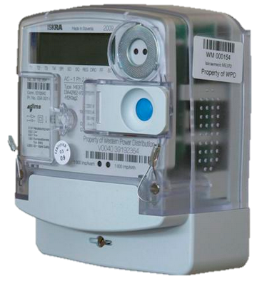
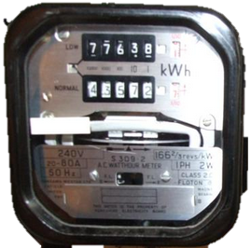
Metering – Half Hourly (HH) Vs Non-Half Hourly (NHH)
HH
NHH
Used in all CVA sites
Used in domestic households
Used in large industrial and commercial SVA sites
Used in small industrial and commercial sites
Records and stores energy flow volumes per half hour
Records energy flow continually and requires periodical meter reads
Easy to use in Settlement
Hard to use in settlement

Slide 9



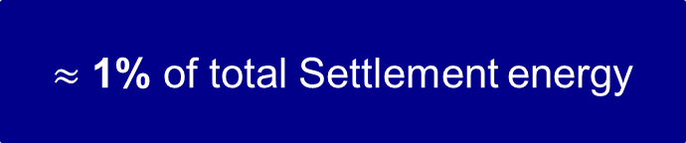
Metering – Unmetered Supplies
We can manage small, predictable loads as
Unmetered Supplies
Street Lights
Traffic Signals
(e.g. traffic lights, belisha beacons)
Miscellaneous
(e.g. cable cabinets)
$≈$ 1% of total Settlement energy

Slide 10
Energy consumption Vs Number of customers
~340k HH customers
~124 TWh HH consumption
~31 million NHH customers
Notes:
****% of consumption figures
31 million
340,000 HH
51.5:47.5:1 (new- Sep-Aug 19-20)
50:49:1 (old)

Slide 11
Suppliers and the supplier HUB

Slide 12
What is a Supplier?
Owned Generation
SUPPLIER
Power Purchase Agreements (PPA)
Payment
Small scale supply
Billing
Wholesale Energy Market
Notes:
Supplier provides generation to customers
They source their generation from their own gen, ppa’s and the energy trading market
Re-coop the costs by billing

Slide 13
What is a Supplier?
Data Collector
Meter Operator
Data Aggregator
SUPPLIER
THE SUPPLIER HUB
Notes:
BSC is just one of many industry codes that puts obligations on Suppliers so appointing Supplier Agents should ensure they remain compliant.
Suppliers have to abide by minimum of 8 codes (MRA, BSC, CUSC etc.)
Must appoint agents in accordance with section J but they are responsible for the actions of their agents.
Section S of the BSC describes the obligations on Suppliers to provide data and ensure that Supplier Agents undertake the requirements defined for them.

Slide 14
Supplier Agent Roles
Meter Operator
(MOP)
Install and maintain meters
Provide Meter Technical Details to DC
Data Collector
(DC)
Collect and validate meter reads
Convert reads to annual values
Data Aggregator
(DA)
For each Supplier, group consumption together by a number of criteria

Slide 15
NHH Settlement: Part 1

Slide 16
NHH Settlement
What about the 30 million customers who only have NHH meters (which are read only a few times a year at most)?
How do we work out what they consumed in a given half hour (Settlement Period)?

Slide 17
What is a Load Profile?
A Load Profile represents the pattern of daily and annual electricity usage for the average customer in each one of the Profile Classes.
There are a number of variables that affect a demand profile such as:
Temperature
(different for
each GSP group)
Sunset time
Day of week
Public Holidays
Seasons
These are all considered when creating the Load Profiles from the sample consumption data.

Slide 18


Sample Profiling
1
2
3
Sample customers’ consumption…
Produce
profile data:
a typical half hourly usage pattern across a year
Apply to all similar customers
Notes:
Around 2,000 customers selected and specialist meters installed to monitor consumption.
Produce profile data based on their patterns and usage over a year
Apply to similar customers based on location, usage etc…

Slide 19
Profile Classes
Profile Class | Type of customer | Description | Example
1 | Domestic | Single/flat electricity rate 24x7 | Domestic premises
2 | Domestic | Multi–rate customers (typically Economy 7 – dual tariff: normal & night) | Domestic premises with switched load capability
3 | Non-Domestic (Commercial) | Single/flat electricity rate 24x7 | Small businesses
4 | Non-Domestic (Commercial) | Multi–rate customers (typically Economy 7 – dual tariff: normal & night) | Small businesses with switched load capability
Notes:
Following the implementation of P272, profile data is no longer collected for PC 5-8 (effectively redundant except for a de minimis amount)
Based on when the demand is used not just the volume.

Slide 20
What is a Load Profile?
A Load Profile represents the pattern of electricity usage by day and by year for the average customer in each one of the four Profile Classes.
Domestic (PC1)
Non - Domestic (PC3)
Annual
Tuesday
Sunday
Notes:
We produce seasonal profiles and profiles per day type which reflect British characteristics.
Here are 2 profile shapes, for domestic and non-domestic customer. One annual, One WD and One NWD.
We can see the Sunday ‘lunch’ tradition during noon, the 1st peak of the day compared to the relatively flat shape of commercial (non domestic) sites.
On a Tuesday we can see a typical profile shape for non-domestic customers, like small businesses, expanding along the working hours of the day, while for domestic customers small peak in the morning and then quite flat shape during the day when people are at work.

Slide 21
NHH Settlement: part 2

Slide 22
NHH Settlement
How can we aggregate all those consumers’ consumption when their meters are read at different times and cover different periods?
EACs and AAs

Slide 23
Settlement Consumption
Annualised Advance (AA)
Estimated Annual Consumption (EAC)
Annual rate of consumption derived by extrapolating a meter advance over a year using a profile
Forward looking estimate (weighted average of previous EAC and the new AA)
EAC
AA
1st Meter Reading
2nd Meter Reading
Notes:
AA- Advance between two reads used to create a yearly profile. (must be over 6 months for an accurate reflection)
EAC- forward estimate, uses AAs to weight the previous EAC.

Slide 24
NHH Data Aggregation (NHHDA)
Each Data Aggregator adds up EAC/AAs for customers with same…
Supplier
Profile Class (PC)
GSP Group
Line Loss Factor Class (LLFC)
Standard Settlement Configuration (SSC)
Time Pattern Regime (TPR)
This gives the Data Aggregator the estimated yearly demand for a ‘Super Customer’
Notes:
LLFC – how much electricity is lost on the network when it gets to that meter
SSC – type of meter (one rate, two rate etc.)
TPR – how the meter behaves at different times
The super customer can be used as a representative figure for each of the categories.

Slide 25
NHH Settlement
The role of a Profile is to turn annual values into HH values. To do this we use a profile coefficient.

Slide 26
NHH Settlement
Meter Advance
AA/EAC
AA
EAC
AA
EAC
EAC
AA
AA
EAC
EAC
AA
EAC
EAC
AA
Aggregated EACs/AAs for Supplier
‘Super Customer’
Period Profile Class Coefficient
X
HH estimate
Notes:
*****March 2018 as example
*************Change/simplify
Meter Advance = Meter Reading #2 – Meter Reading #1
AA = Meter Advance / sum(Daily Profile Coeficients)
Use AA and sum(Daily Profile Coefficients) to calculate EAC

Slide 27
Applying the Period Profile Class Coefficient
1
GSP Group _C
2
2
Customers of Supplier X Limited…
Aggregated annual
consumption of
2,000,000 MWh
Profile Class 1
LLF Class 100
SSC 0393
Notes:
Annual consumption for all customers grouped into these specifics is aggregated

Slide 28
Applying the Period Profile Class Coefficient
3
4
Settlement Period 14:30 to 15:00 on 17 July 2020
Period Profile Class Coefficient (PPCC) = 0.00006
Aggregated annual
consumption of
2,000,000 MWh
Period Profile Class Coefficient (PPCC) of 0.00006
X
=
customers are estimated to have used 120MWh during this Settlement Period
Notes:
And multiplied by the profile co-efficient for a given settlement period.
This provides an estimate to a supplier how much energy these customers will use.

Slide 29
GSP Group Correction

Slide 30
Grid Supply Point (GSP) Groups
North Scotland
14 host Distribution Networks take energy from the Transmission Network at defined Grid Supply Points.
These networks are also known as GSP Groups.
South Scotland
North Western
Northern
Merseyside & North Wales
Yorkshire
East Midlands
Midlands
South Wales
Eastern
London
South Western
South Eastern
Southern

Slide 31
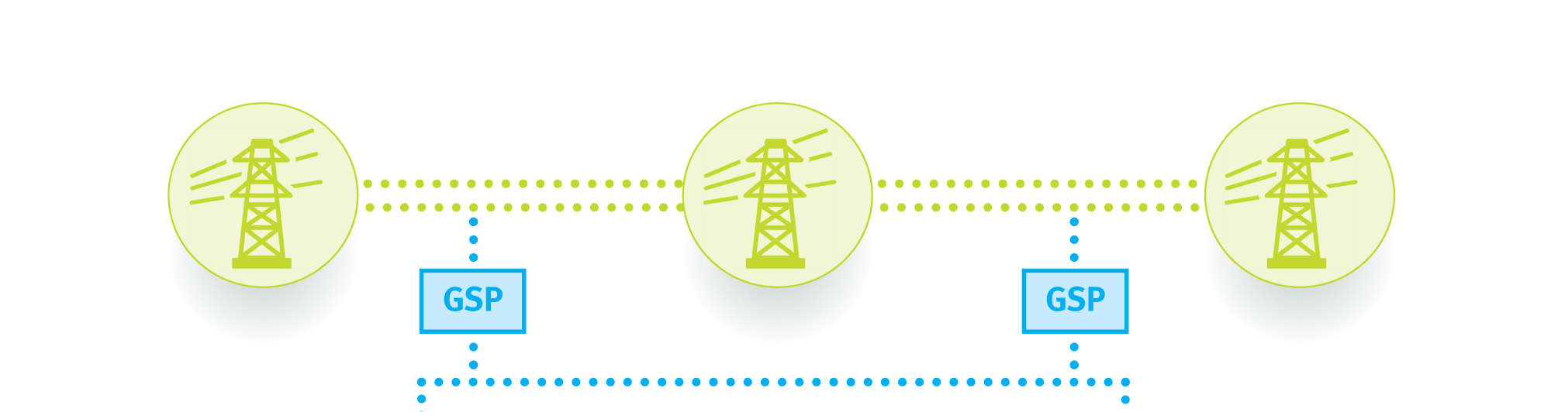

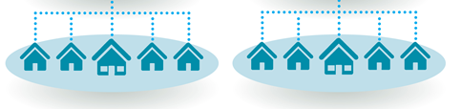
GSP Group take – top down and bottom up
What goes into the distribution region

Slide 32
GSP Group Correction
Using GSP meter reads, we work out what energy enters (or leaves) each Distribution Network per Settlement Period. This is called the Group Take.
GSP Group Correction Factors scale Suppliers’ volumes up or down, so that the total of the corrected volumes equals the GSP Group Take.
Any errors are effectively ‘smeared’ across Suppliers according to their market shares in that GSP Group and Settlement Period.

Slide 33
GSP Group Correction
Profile Build Up - Uncorrected
1800
1600
1400
1200
HH
Unmetered
MWh
1000
PC4
PC3
800
PC2
PC1
600
Group Take
400
200
0
1
2
3
4
5
6
7
8
9
10
11
12
13
14
15
16
17
18
19
20
21
22
23
24
25
26
27
28
29
30
31
32
33
34
35
36
37
38
39
40
41
42
43
44
45
46
47
48
Settlement Period

Slide 34
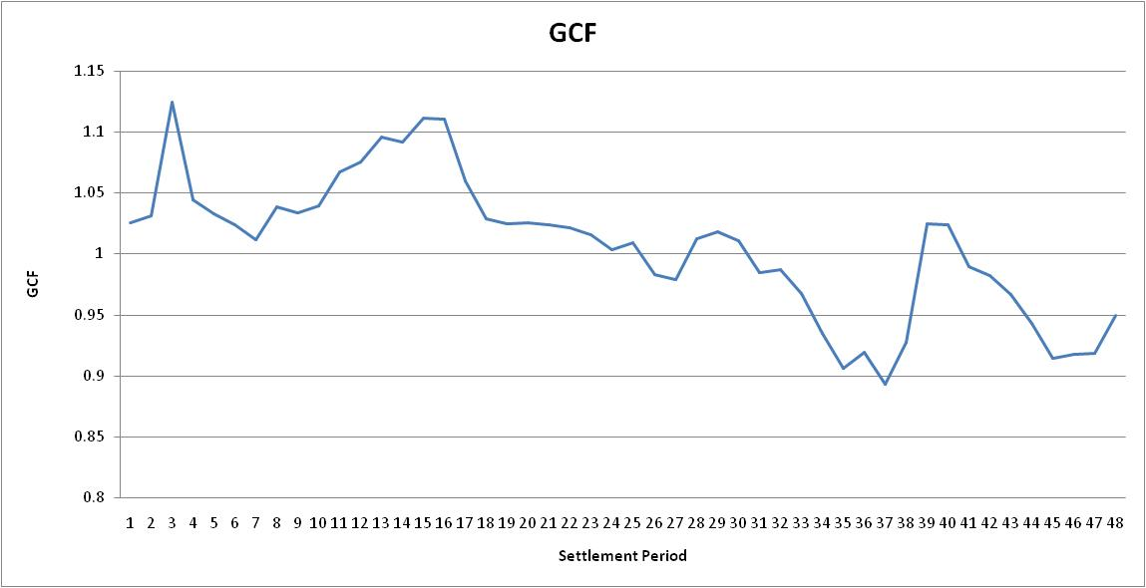
GSP Group Correction Factors

Slide 35
GSP Group Correction- What is it correcting for?
There are two main potential sources of error:
Profiling error
Some examples:
Sampling errors
National profiles applied to regional GSP Groups
Special days e.g Easter and Christmas
Volume error
Some examples:
Large EACs and AAs
Undetected theft

Slide 36
Settlement Process

Slide 37

SVA Settlement process

Slide 38
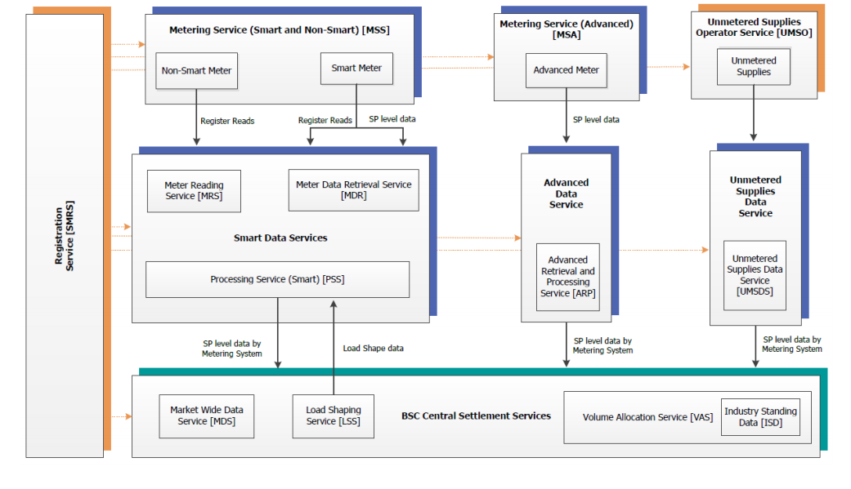
Future SVA Settlement process changes?
Ofgem’s Significant Code Review – Electricity Settlement Reform (https://www.ofgem.gov.uk/electricity/retail-market/market-review-and-reform/smarter-markets-programme/electricity-settlement-reform)
Market-wide HH Settlement

Slide 39
Settlement
BSC Party
Settlement Invoice
Energy Contracts
Production Account
Consumption Account
Credited Energy
E_BMU
T_BMU
2_ABMU
2_BBMU
Aggregated data from meter points
Aggregated data from meter points
Meter Point
Meter Point
Notes:
Invoice sent daily if <£500, otherwise wait until reach £500 or quarter
Need to balance each account separately

Slide 40
nick.baker@elexon.co.uk
ANY QUESTIONS?
020 7380 4337

